Slide 1
High Performance .NET Programming
@markrendle – Itkonekt Belgrade 2024

Slide 2
The One Billion Row Challenge

Slide 3
The Challenge
UTF-8 text file
One billion lines
Weather Station name and Temperature, separated by semicolon
Calculate Min, Max and Mean temperature for each station
DO IT FAST

Slide 4
Data
Da Lat;-46.821 Alexandra;-17.772 Pretoria;40.061 Mumbai;16.426 London;-3.135 Phoenix;21.948 Kumasi;42.886 Yakutsk;-23.005

Slide 5
Naïve implementation

Slide 6
UTF-8

Slide 7
BenchmarkDotNet

Slide 8
BenchmarkDotNet
Micro-benchmarking library
Measure iteration time
Record:
Allocations
IL and ASM
For up-front optimization

Slide 9
UTF-8 + StringPool

Slide 10
UTF-8 cheat mode

Slide 11
SafeFileHandle

Slide 12
Parallelization

Slide 13
Memory Mapped Files

Slide 14
Unsafe Work Stealing

Slide 15
Native AOT

Slide 16
Profile-Guided Optimization

Slide 17
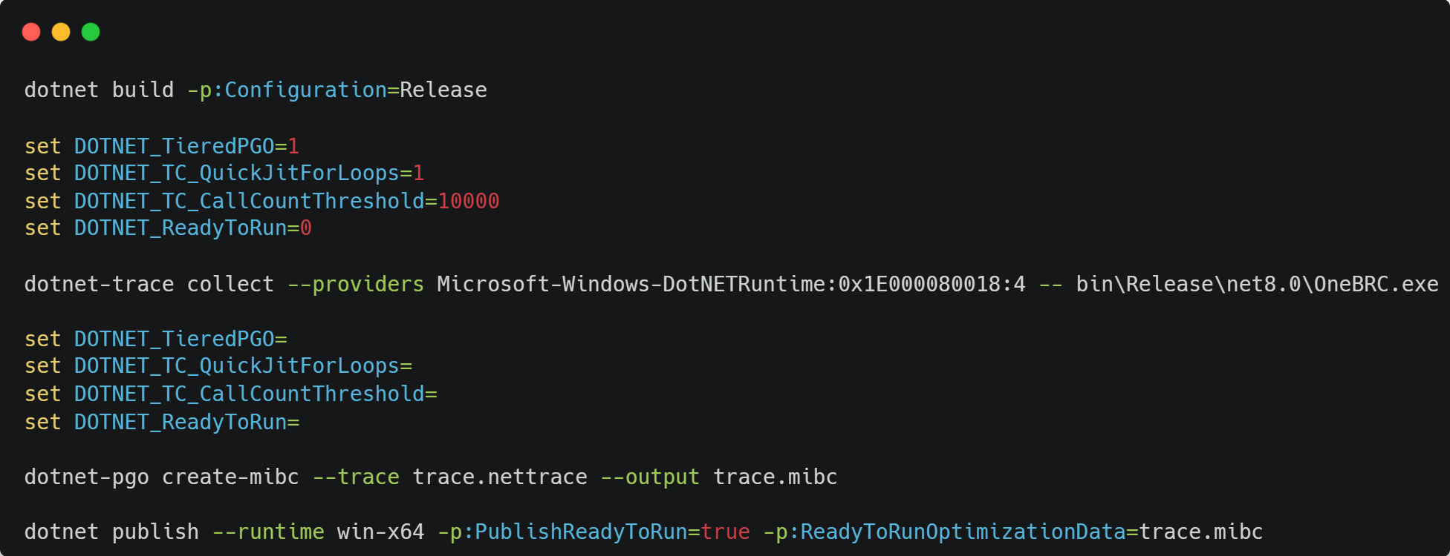
HOWTO PGO

